Slide 1




The Asgaurdians
Home
About
Product
Contact
JOB WIND
A Job portal website

Slide 2


Home
About
Product
Contact
Introduction
Looking for a new job is a complex dynamic process.
Finding the "correct" applicant to call for job interviews is a particularly difficult challenge.
We plan to develop an improved online job portal site that gives job recruiters information to help them optimize their job applicant search approach.
This will specifically assist job recruiters in spotting suitable applicants.
It will provide suggestions to current job searchers regarding occupations.
We will create a variation of the site that takes their unique skills, abilities, and other personal traits information from job applicants into consideration.
As a result, we will also give job search assistance that is highly personalized and takes into consideration the job seeker's unique position.

Slide 3


Home
About
Product
Contact
Why is this different?
This website is focused on skills-based search.
which makes it very easy for recruiters.
also, it helps the skilled applicant to find the right job.
Current job websites can search for jobs from the applicant's point of view.
But this website will mainly be built from the recruiter's point of view which they can search for suitable people for their job using their skillset.
This is mainly focused on university graduates.
so, the user base is knowledgeable and skilled.
this is the platform to come if you are a recruiter and you are looking for fresh undergraduates.

Slide 4



Home
About
Product
Contact
Goals & Objectives
Goals
Develop a system that connects job applicants and recruiters.
01
Create a user-friendly job portal with essential functions.
02
Develop a Database for maintaining user and job recruiter records.
03
Develop a specific ‘Filter’ function for skills and abilities.
04

Slide 5
Home
About
Product
Contact
Goals & Objectives
Objectives
Create a function for job recruiters to contact job applicants when needed.
01
Develop a more user-friendly job portal that has multiple options when searching/filtering.
02
Maintain the Database more efficiently alongside cloud facilities.
03
Improve user experience and provide an attractive User Interface.
04

Slide 6








Home
About
Product
Contact
Methodology
Agile
Understanding the client’s requirement
Designing the requirements
Develop/ iteration
Testing & Deployment
User’s Feedback

Slide 7
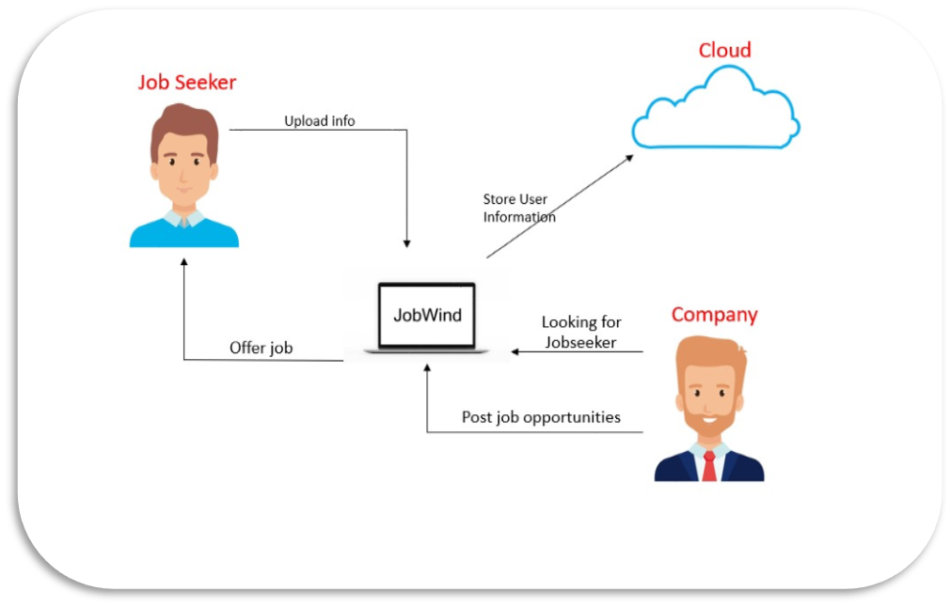
Home
About
Product
Contact
System Diagram

Slide 8
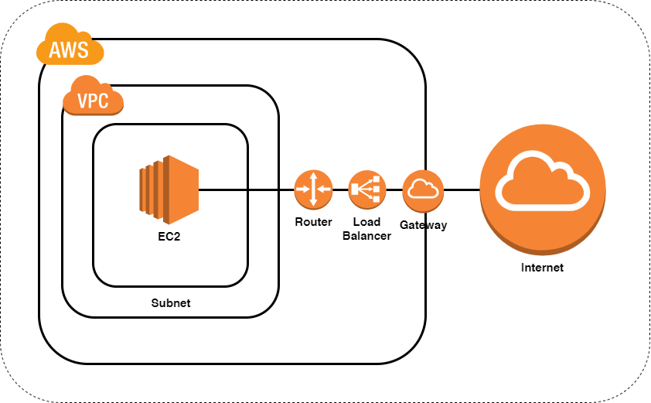
Home
About
Product
Contact
Cloud Architecture

Slide 9











Home
About
Product
Contact
Expected Tools
& Technologies
Authentication
Google authentication
Analytics
Google Analytics
UI Designing
Google Tag Manager
Adobe XD
Figma
Web Development
Cloud Provider
Amazon Web Services

Slide 10

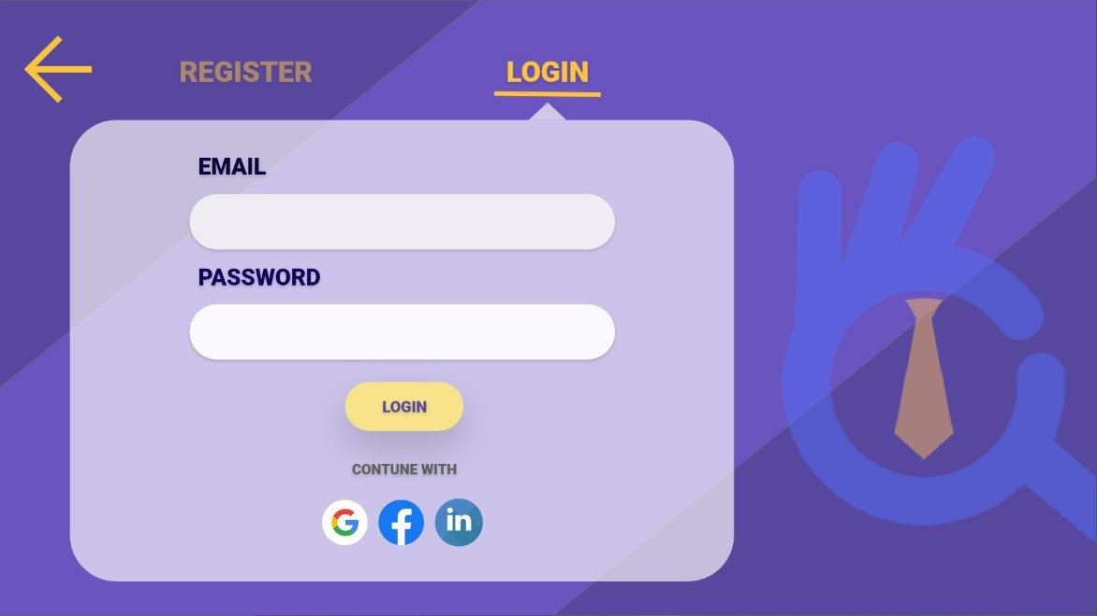
Home
About
Product
Contact
Demo User Interfaces

Slide 11
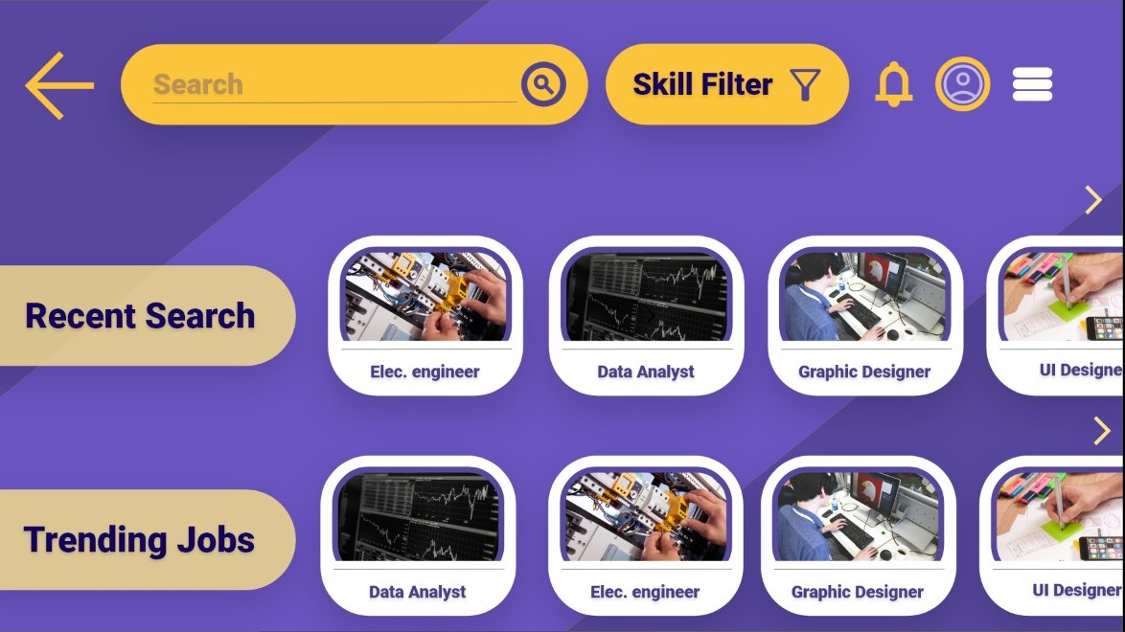
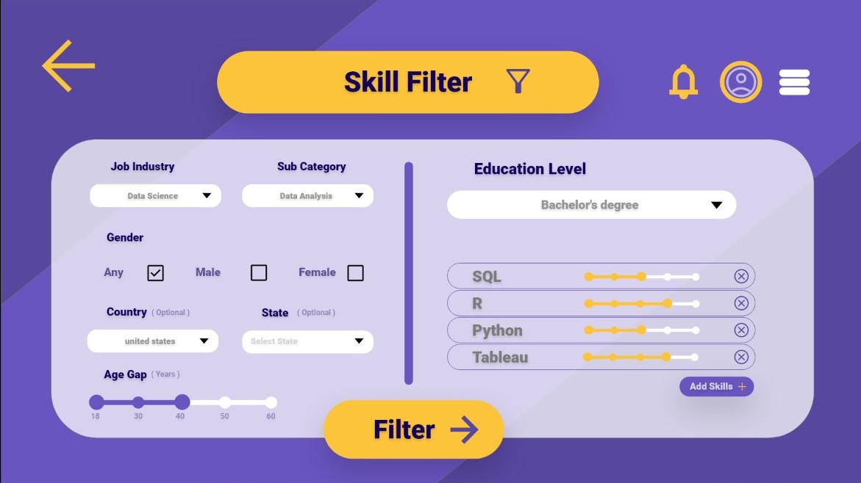
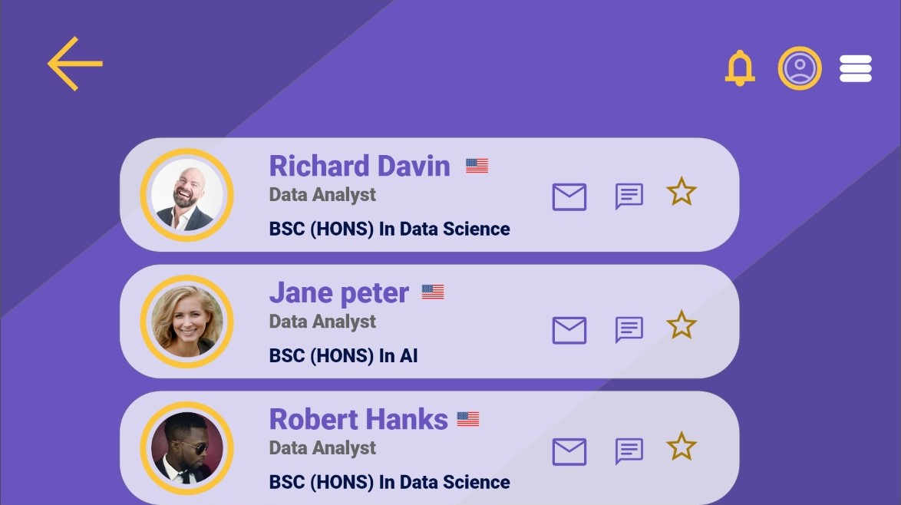
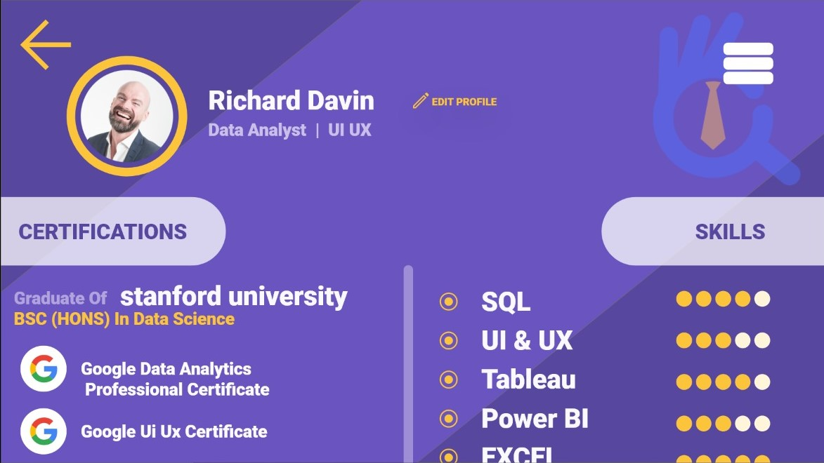
Home
About
Product
Contact

Slide 12
Home
About
Product
Contact
Project Scope
Project Deliverables
Risks and issues
Provide a fully functioning job portal website that can,
Filter job applicants according to their skill set.
Maintain job seeker and employer records.
Alert or contact job seekers if job recruiters decided to choose for interviews.
Privacy issues.
Lack to meet the job recruiter’s requirements.
Currently focused on the IT Industry only.
All team members have only basic ideas about web and cloud development.
Assumptions
Assume there are enough funds for the project.
Assume job applicants will go to our website and upload their resumes.
Assume job recruiters use our website to find suitable applicants.
Assume the project will fully meet the business’s needs.
Assume this project will reach the global market

Slide 13

Home
About
Product
Contact
Project Team
A.T.Satharasinghe
M.K. Damindu Pahasara
A.S. Bandarathilaka
S.B.M.P. Adithya Srinarayana
D.M. Pavithra Nirmana
D.S.V. Danthanarayana
B.B. Gunarathna
D.M.K.G.Buwaneka Madushan Amarakoon
A.M.K.B.Nipun Aththanayake
S.A.N.S.Wijayananda
(AA1929)
(AA1680)
(AA1706)
(AA1853)
(AA1800)
(AA1667)
(AA1698)
(AA1817)
(AA2074)
(AA1831)

Slide 14
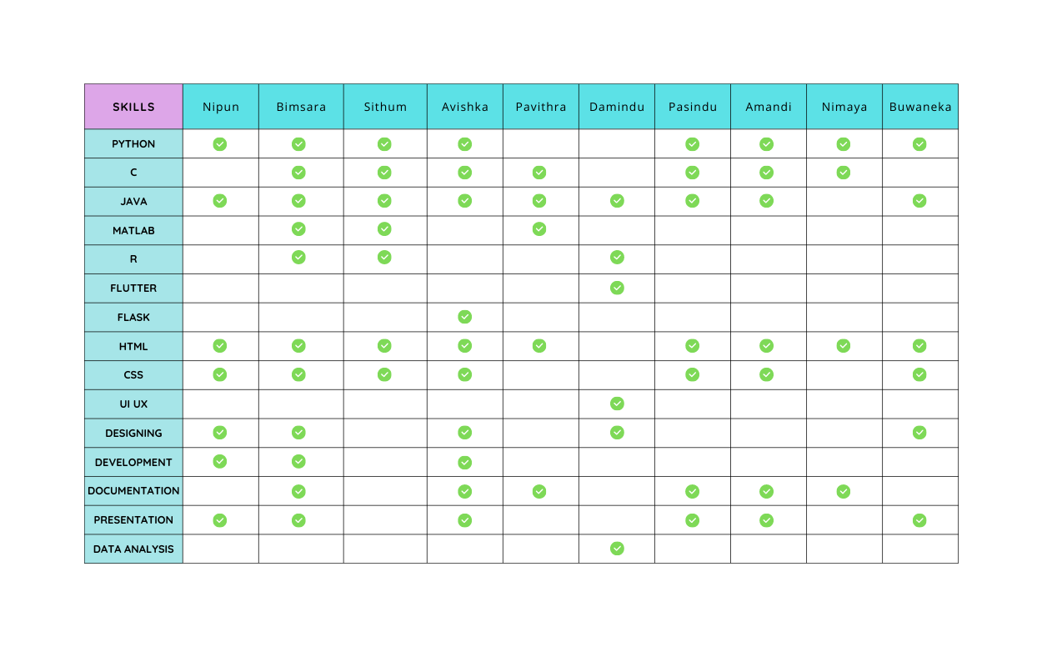

Home
About
Product
Contact
Skills Matrix

Slide 15
Home
About
Product
Contact
Time Schedule
GANTT CHART
JOB WIND - JOB PORTAL WEBSITE
TASKS
RESEARCH
BASIC UI/UX DESIGNING
WEB DEVELOPMENT – STAGE I
WEB DEVELOPMENT – STAGE II
WEB DEVELOPMENT – STAGE III
WEB DEVELOPMENT – STAGE IV
PRODUCT TESTING
PROJECT HANDOVER
OCTOBER | NOVEMBER | DECEMBER | JANUARY

Slide 16


Home
About
Product
Contact
Conclusion
The main goal of this proposed system is to highly digitize employment queries.
So that job recruiters can easily find suitable applicants. This will let the employers/recruiters filter job seekers according to their requirements.
Also, post an update about the available jobs and the qualification needed for them.
And for job seekers to find the right and satisfactory job according to their qualifications So, it enables applicants to search for jobs conveniently and enables employers to find suitable candidates.
In the current manual system, viewing available jobs also require so much time and effort because job seekers will manually go and check for it at the agency. As a solution, this job-hunting web application is going to be developed.

Slide 17
Home
About
Product
Contact
Thank You!

